Slide 1

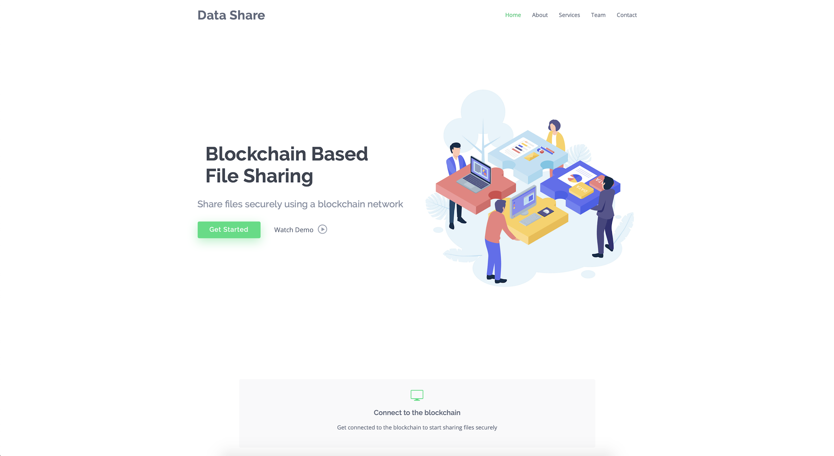

DATA SHARE
Blockchain based File Sharing System
Ruchika Tulsyan (BE/10090/16)
Souvik Saha (BE/10011/16)
Project Guide :
Dr. Shamama Anwar
Github link to our project:
https://github.com/ruchi26/Blockchain-based-Decentralized-File-Sharing-System-using-IPFS.git

Slide 2
INTRODUCTION
Data Share aims at creating a decentralized system where files can be shared securely.
By integrating blockchain technology, we make sure that the files shared on the network cannot be tampered or corrupted and the complete history of all the files shared will be stored giving users a sense of security.
Technologies used:
Blockchain
IPFS
AES Encryption

Slide 3
BLOCKCHAIN
Blockchain is a decentralized distributed database existing on multiple computers at the same time. It is constantly growing as new sets of recordings, or ‘blocks’, are added to it.
Each block contains a timestamp and a link to the previous block, so they actually form a chain.
Everyone in the network gets a copy of the whole database. Old blocks are preserved forever and new blocks are added to the ledger irreversibly, making it impossible to manipulate by faking documents, transactions and other information.
The blocks are cryptographically linked together.

Slide 4
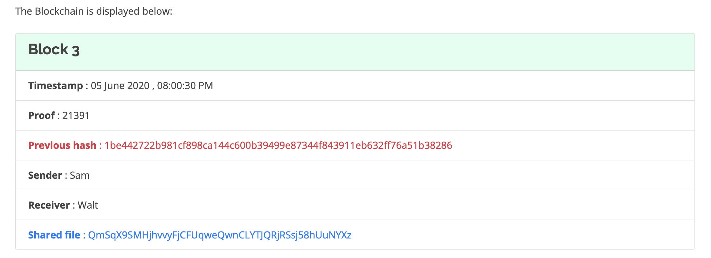
Block Structure
Nonce to uniquely represent a block
SHA-256 hash of the Block 2
Data stored in the blockchain
Hash of the shared file generated by IPFS using AES Encryption and SHA256 hashing algorithm

Slide 5
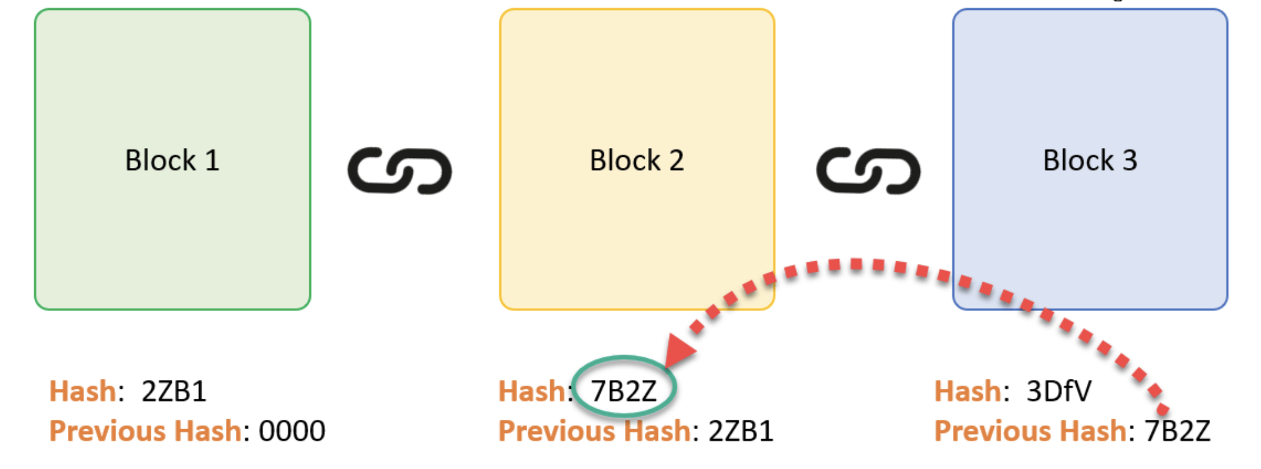
BLOCKCHAIN

Slide 6
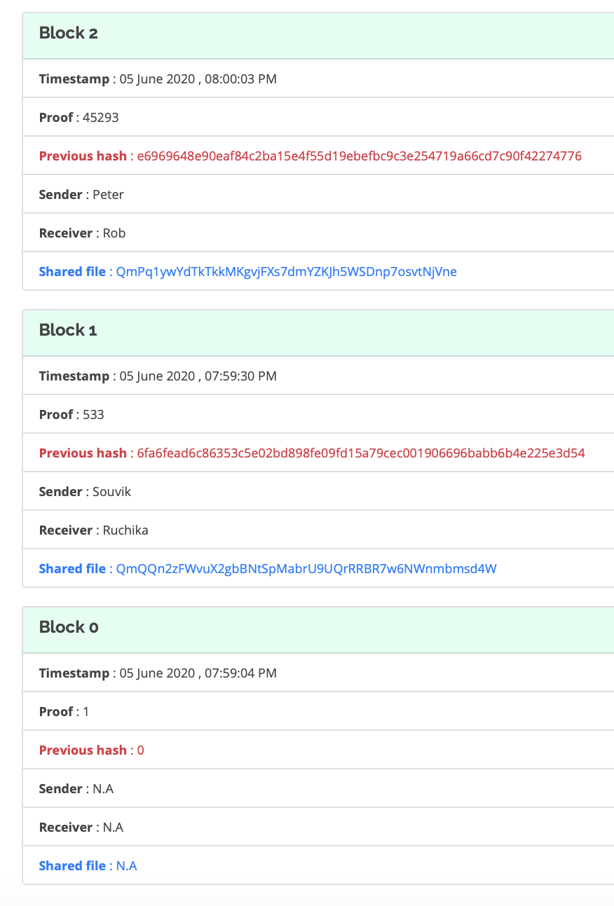
Blockchain with three blocks cryptographically linked together
Blocks are linked together cryptographically using the SHA-256 hashes of the previous blocks
Genesis Block

Slide 7
Why Blockchain
Independent and Decentralized
Transaction Transparent
Data Integrity
Cost and Risk Reduction
Data Security

Slide 8
IPFS - Interplanetary File System
IPFS is a versioned file system which can store files and track file versions over time.
It is a protocol and peer-to-peer network for storing and sharing data in a distributed file system.
It uses content-addressing to uniquely identify each file in a global namespace connecting all computing devices.
It uses Distributed Hash Tables (DHT). In DHT the data is spread across a network of computers, and efficiently coordinated to enable efficient access and lookup between nodes.

Slide 9
Why IPFS
Decentralization - Nodes do not require central coordination.
Fault Tolerance - The system can function reliably even when nodes fail or leave the network.
Scalability - DHTs can scale to accommodate millions of nodes
Overcoming the weakness of Blockchain - Instead of storing the whole file on the blockchain, we only store the file’s hash generated by IPFS to make the blockchain light and more efficient.

Slide 10
Tools Used
Platform : Visual Studio Code
Web Framework : Flask
Code version control : GitHub
Front - end : HTML5 , CSS , BOOTSTRAP 3
Back - end : Python 3

Slide 11
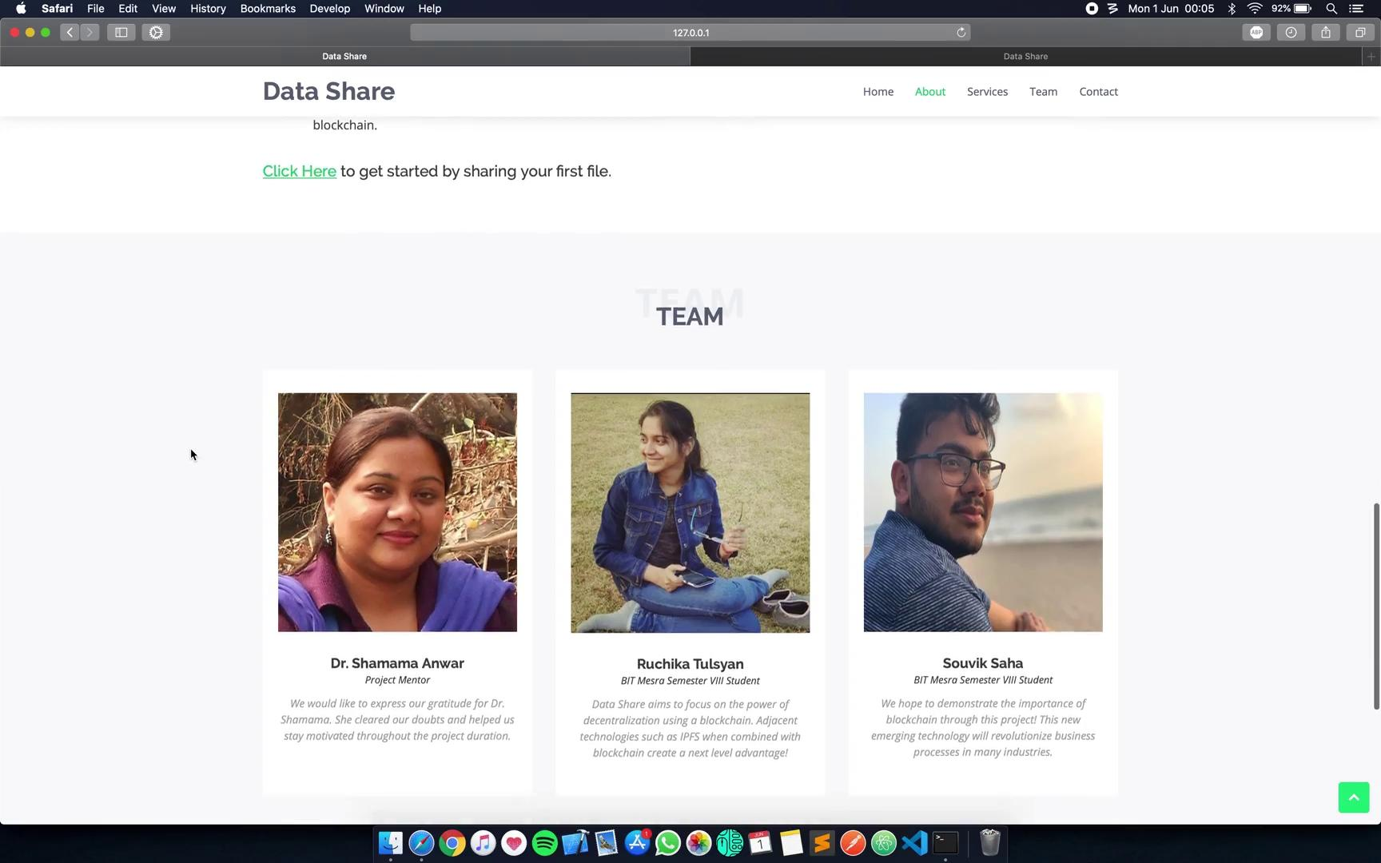
WORKING

Slide 12
USE CASES
There’s going to be no “servers” hosting websites. All the content will be served from IPFS and data pulled from the blockchain directly.
Users won’t have to “sign up” for accounts. Their private key will grant permission and access to their identity to websites/providers.
Direct communication with another party without anyone in the middle. Truly secure, private and censorship free communication applications.
Social networks where one’s information is only available to those who they give permission to.

Slide 13
LIMITATIONS
Data Share currently accepts individual files ( .txt, .png, .jpg, .jpeg, etc). It can be updated to accept folders as well.
Huge file sizes can cause the blockchain to become slow due to the cryptographic encryption, thus requiring adequate computational power.
Data Share was originally intended to be a disk-space sharing platform based on blockchain but due to the current circumstances, it was pivoted to a file sharing platform.

Slide 14
CONCLUSION
Blockchain can be set up to operate in a variety of ways, using different mechanisms to secure a consensus on transactions, seen only by authorized users.
Blockchain depends on scalability and does not work well if the file size is too big, but when combined with IPFS, it could overcome this disadvantage and help redefine the way we interact with information and identity.
Blockchain holds enormous potential in the future. This technology will not only save your time and money but it will revolutionize many industries.

Slide 15
FUTURE SCOPE
Data Share currently runs on a local network but it can be made to function on any public network with web hosting, thereby making it more scalable.
Upon proper exploration, blockchain could prove to be a boon for leading industries like digital advertising, cybersecurity, supply chain management, networking and forecasting.

Slide 16
REFERENCES
http://www.ijsrr.co.in/images/full_pdf/1559214929_779.pdf
https://www.guru99.com/blockchain-tutorial.html
https://docs.ipfs.io/introduction/overview
https://medium.com/@mycoralhealth/learn-to-securely-share-files-on-the-blockchain-with-ipfs-219ee47df54c
https://flask.palletsprojects.com/en/1.1.x/
https://www.comparitech.com/blog/information-security/what-is-aes-encryption/
https://stackoverflow.com/questions/42857515/what-is-blockchain-and-ethereum-where-is-it-used

Slide 17
Thank you

